Slide 1
Small Changes, Big Improvements
Tips for bettering your photography

Slide 2
IFAS Photography Services
Tyler Jones and Cristina Carrizosa – ICS Photographers
IFAS Photography covers IFAS events, research documentation, conferences/symposiums, portraits, news releases, publications, and more.
Photography services can be requested via Workfront.

Slide 3
Know What You Want to Communicate
All photographs should have a message/purpose. Why did you take it and what does it say?
Prior to taking the photo, consider:
What motivated you to want to take a photo?
What ways might you take it? What could you include or exclude to clarify that meaning?
What would be the simplest representation of the subject?

Slide 4
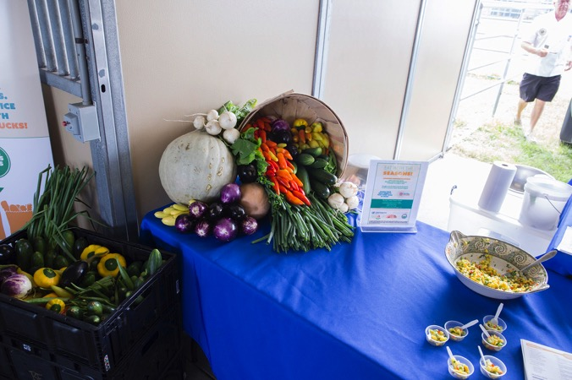
Take Photos with Intent
Poor intent
With intent = greater effectiveness

Slide 5
Shoot When the Light is Right
For most subjects, the first two hours after sunrise and the last two hours before sunset.
Early and late light gives the best color.
Lower angle of sun = more flattering illumination and less overhead shadows
Put the sun at your back unless you intend to silhouette a subject or are using fill flash.
For the best indoor natural lighting, try to place your subject close to a window allow them to be illuminated by natural daylight.

Slide 6
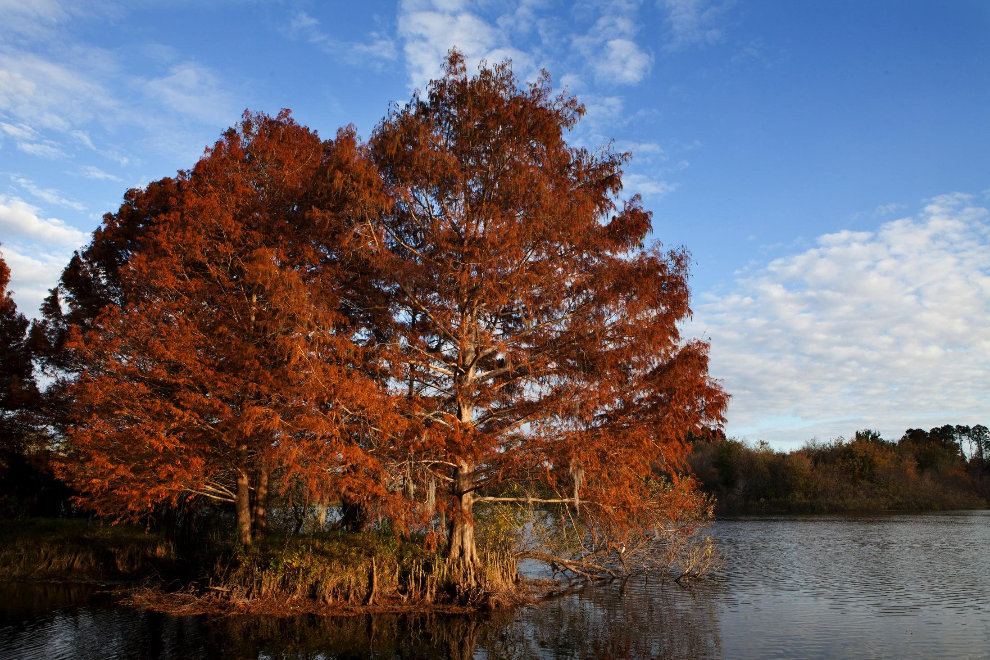
Lighting Examples
Mid-day light
Late afternoon light

Slide 7
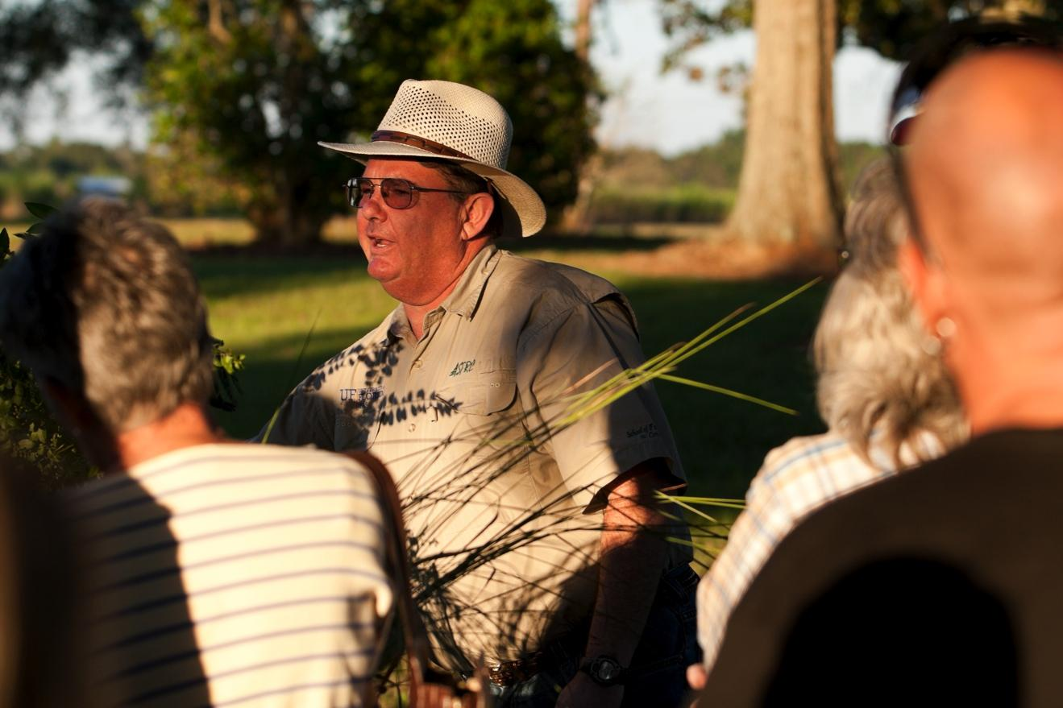
More Lighting Examples
Late afternoon light
Mid-day light

Slide 8
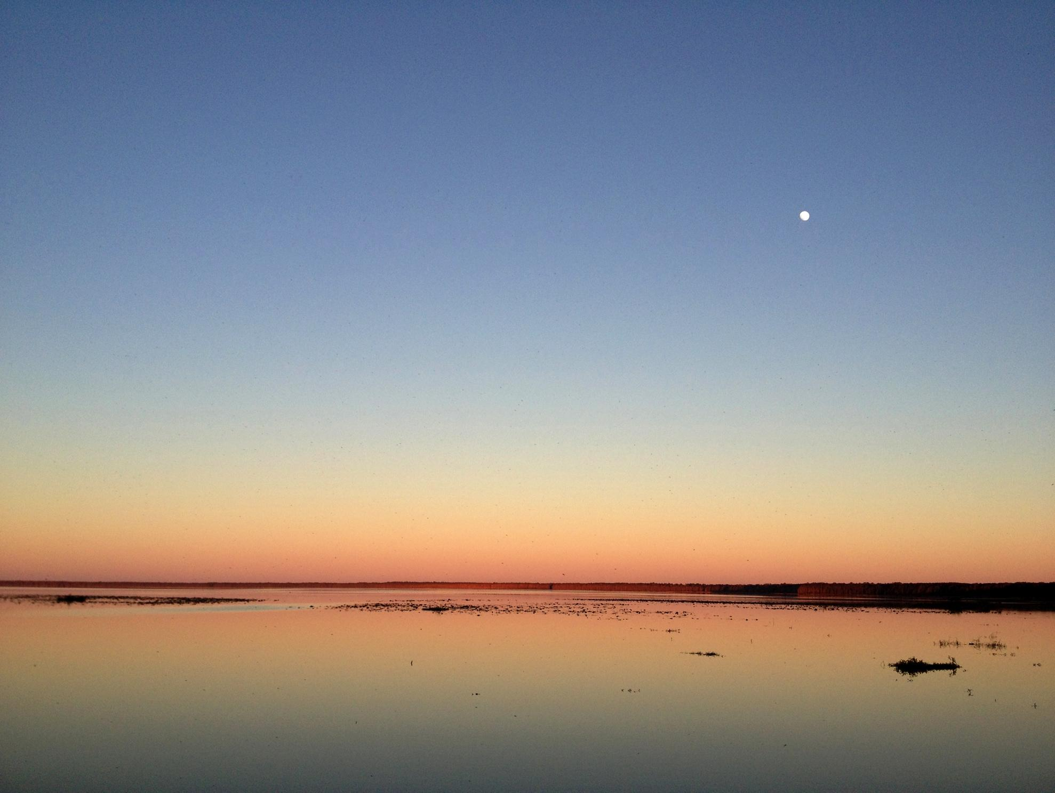
Dawn and Dusk Light
Notes:
-Photos taken at these times will often require a tripod, a mini-tripod, or at least the phone/camera propped up on something to avoid having a blurry photo. There is not much light at these times, so the camera shutter must stay open for a longer period of time, if you’re hand holding the camera then it will often detect your hand movements, however small, over that time period, thereby necessitating the tripod or prop of some kind. Some phones and dedicated camera lenses and camera bodies now have an image stabilization that can compensate with this adequately to allow for hand holding in these low light levels, so understand if your phone camera has that and turn it on if you’re taking photos in low light levels.

Slide 9
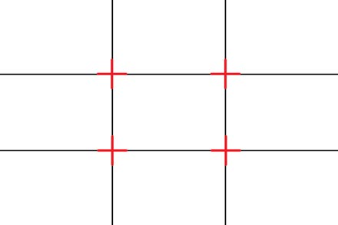
Compose with the Rule of Thirds
Primary subject or the focal point of a subject should be situated along a third of the frame
Avoids the “Bulls-eye Effect,”
of central subject placement
Turn on camera or phone grid overlay as an aid

Slide 10
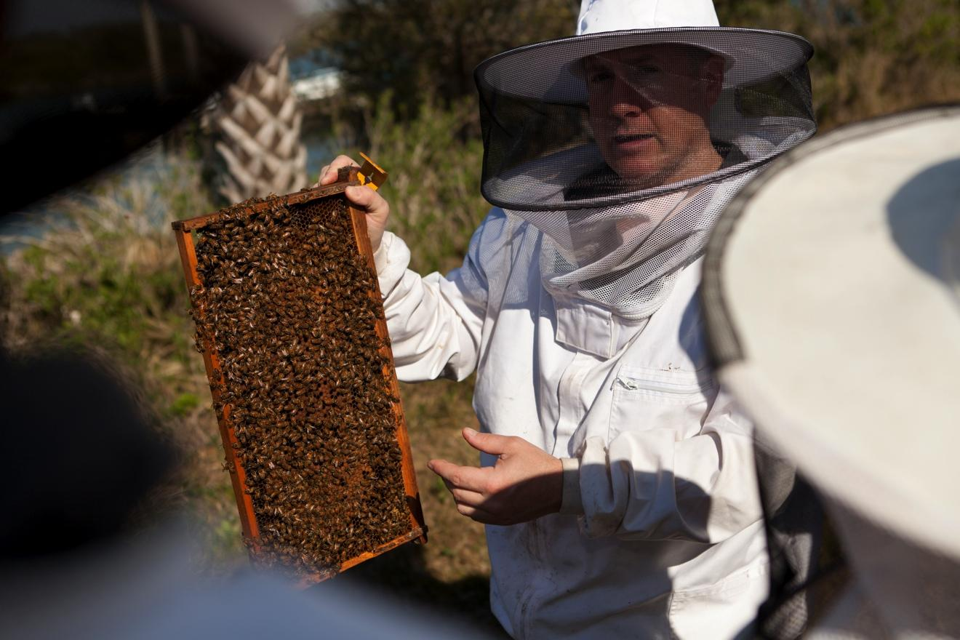
More Rule of Thirds Examples
Above = primary subject falls along left or right 2/3rd mark
Notes:
-Also notice how the second of these two images also succeeds in creating dimension and depth by having the primary focus of the subject, the green peppers, close in the frame and the rest of the display recedes into the distance.

Slide 11
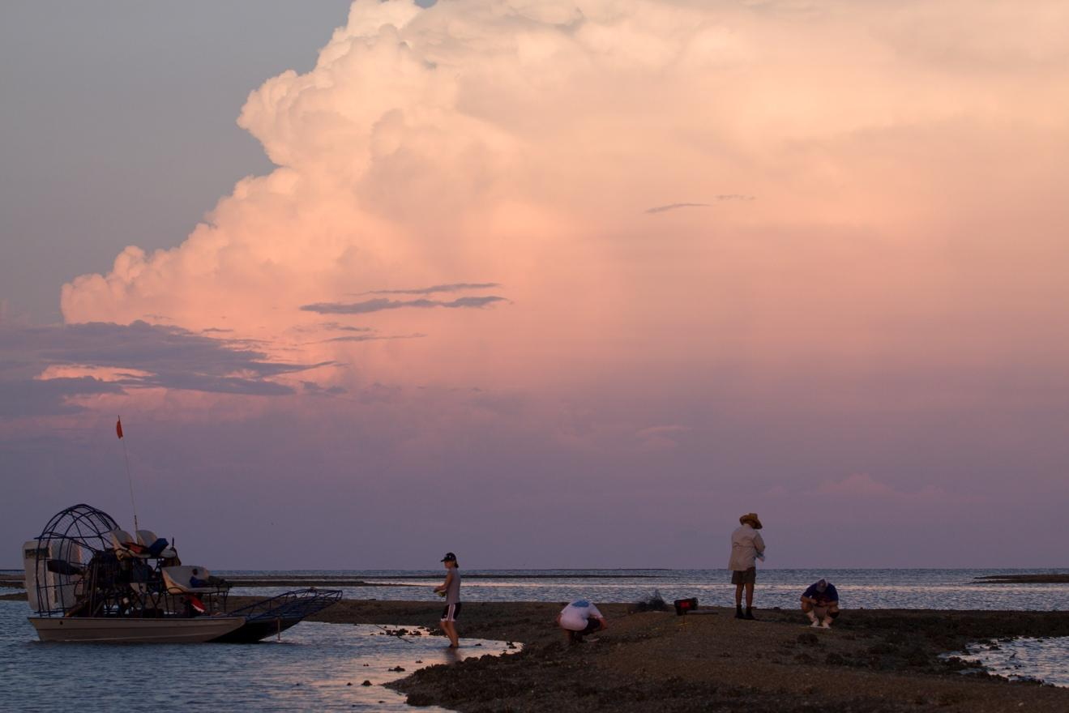
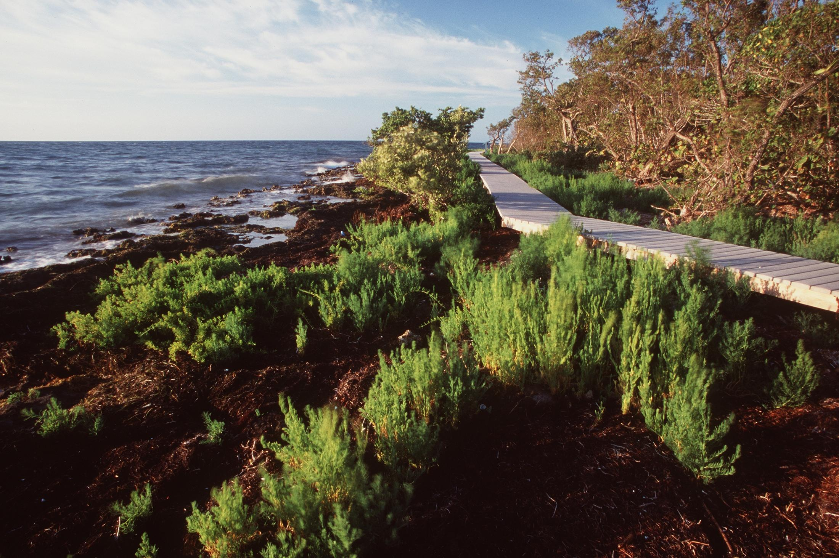
Rule of Thirds: Landscapes
Place the horizon line at an upper or lower third depending on whether the sky or the landscape is the primary subject.

Slide 12
Be Aware of Your Background
Position subject so that there is nothing too distracting behind it/them
Distractions can be but are not limited to: bright colors, lines and patterns, people, signs, text, tree limbs, etc.
You have the preview of the final photo on your phone or camera’s screen, so pay attention to it before pressing the shutter button.
Notes:
-Many current generation phones have a “portrait mode” that artificially mimics the narrow depth of field and subject isolation sometimes associated with professional cameras and optics. Utilizing portrait mode for correct subjects, which are typically photos of individual human subjects from about the waist up or tighter can effectively reduce distracting backgrounds you may not have been aware of while taking the photos. The effect can be distracting and unnatural looking in the incorrect contexts though, so be selective as to when you use it.

Slide 13
Focus Your Image
For human subjects, the focus point should most often be on the primary subject’s eye that is closest to the camera.
Focus lock: Half press your camera shutter button while the selected focus box is on the part of your subject you want to have in focus, then while continuing to hold the shutter half pressed, recompose your image and press the shutter all the way down, taking the photo.
Smartphones can produce a shallow depth of field (think isolated subject with blurry background) artificially with their “portrait mode” but this is applied with in-phone software when the photo is taken, and is not a true optical effect.
Notes:
-Current generation, middle to high-end dedicated camera models now have reliable autofocus tracking methods, which can be very useful for human and animal subjects that move often and quickly are capable of keeping focus locked on the eyes and faces of those subjects so that all the photographer has to do is move the camera to keep them in the frame where they want them while pressing the shutter button to take the photos. However, that is a feature that is generally reserved for the highest end professional or sports-oriented cameras, so it can be very expensive to obtain that feature in a camera.

Slide 14
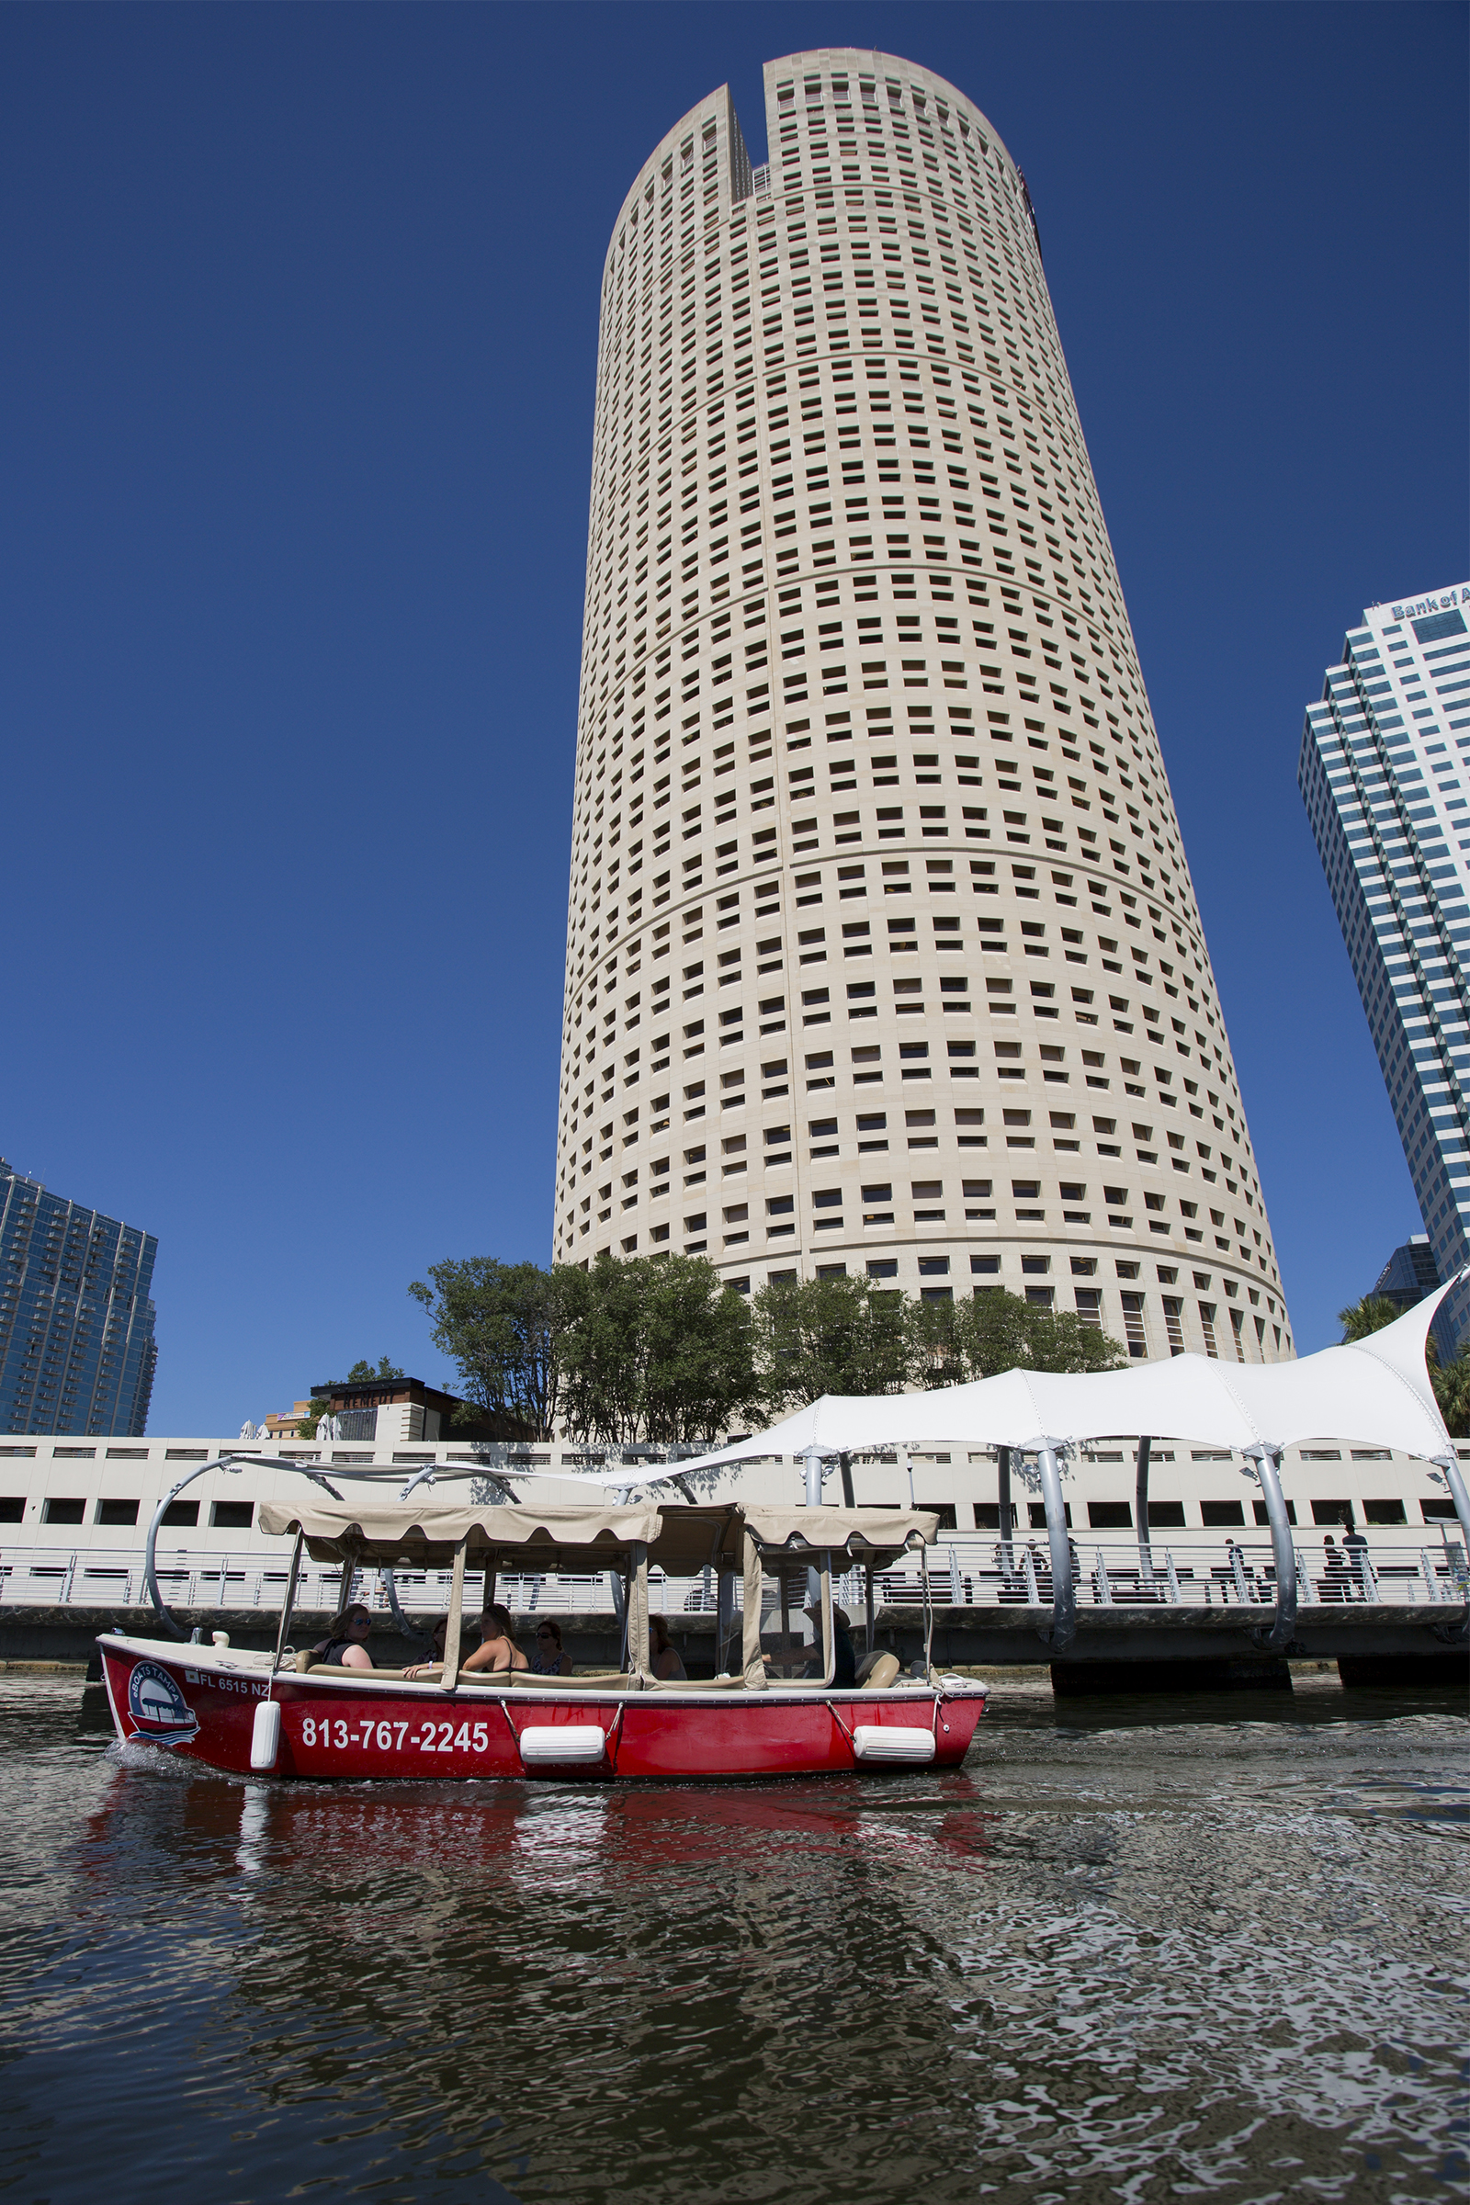
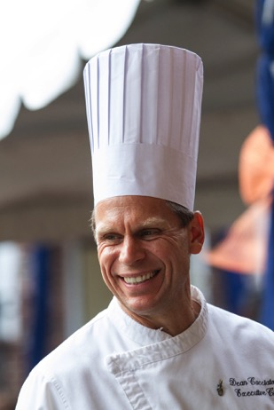
Use Horizontal and Vertical Frames
If your subject is naturally long and vertical, then turn your camera vertical, unless you intend to include a lot of negative space for text, graphics, etc.
Notes:
Some subjects have a natural vertical or horizontal structure, so part of shooting with intent is to frame the image in a way that is complimentary to the natural orientation of the scene before you.
Notice the application of Rule of Thirds in each of these images. In the first image, the food item that is most in focus, the one I want the viewers eye drawn to first, falls along the lower third. In the second image of the chef, his face/smile, while a slightly high in the frame, is roughly at the bottom third. In the last image at far right, the “Field & Fork Pantry Open” signage is the primary focal point and is at the bottom right third of the photo.
Credits
All images on this slide are courtesy of UF/IFAS Communications

Slide 15
Shoot from Diverse Angles
Move around the subject while you shoot.
Don’t be afraid to use low or high angles.
Avoid shooting every subject straight on with camera at eye level.
Create dimension and depth by having the primary subject closer in the frame and background receding

Slide 16
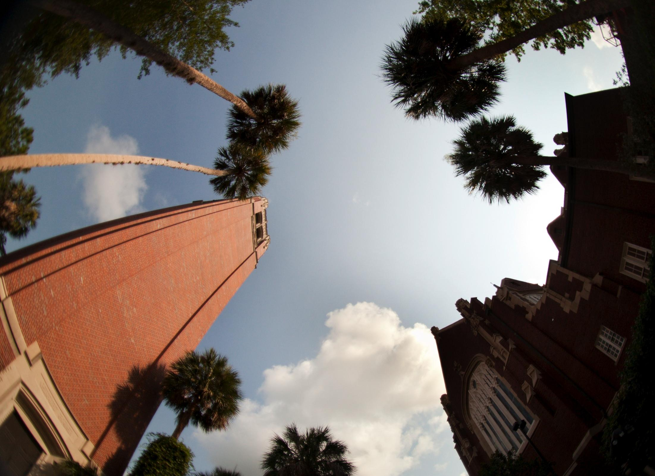
Examples of Diverse Angles/Perspective
Above = wide elevated perspective Above = fisheye lens wide and low

Slide 17
Visual Story Telling
Combing a diversity of focal lengths (different lenses/perspectives) with a diversity of angles (high, low, off to the side, close-up, etc.) while photographing any subject, creates dynamic and visually interesting visual storytelling and narratives.
Notes:
Different perspectives best achieved by utilizing different focal length lenses on interchangeable lens cameras (ie: wide angle 16-35mm, normal 35-60mm, and telephoto 85mm+), or with a phone by physically moving the subject closer or farther from the subject. However, the most current generation of phones now come with an array of multiple lenses, so if yours does, understand which lenses you have and what kind of subjects they are best utilized for and actively switch between them.

Slide 18
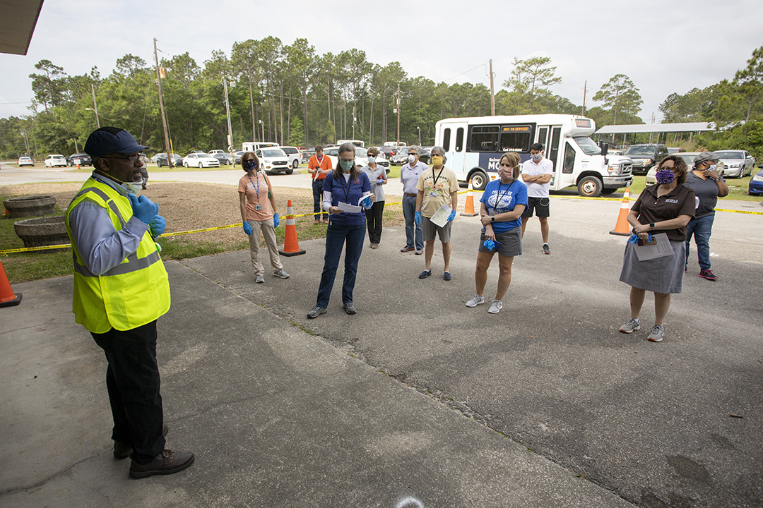
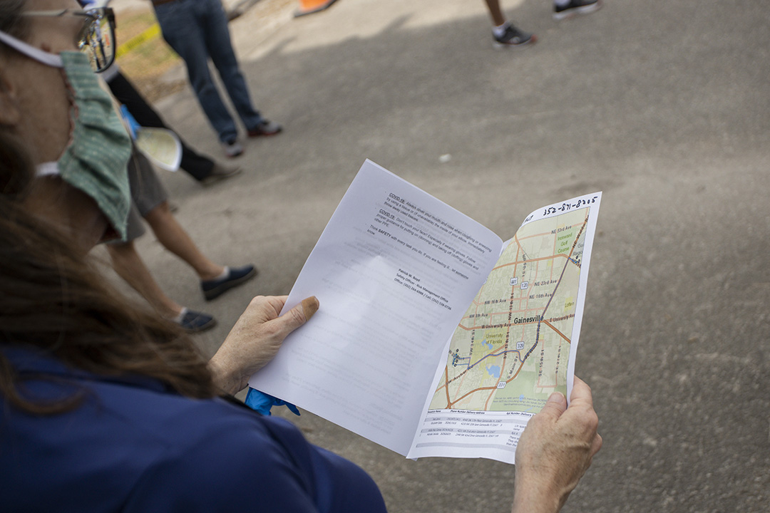
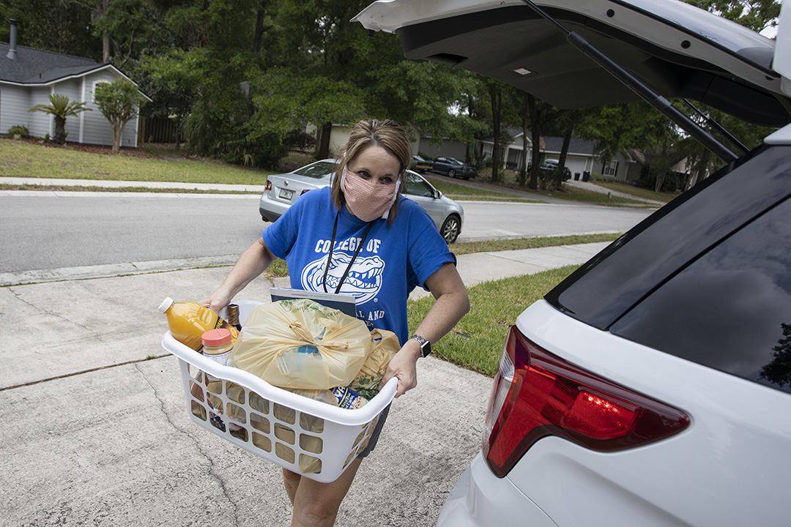
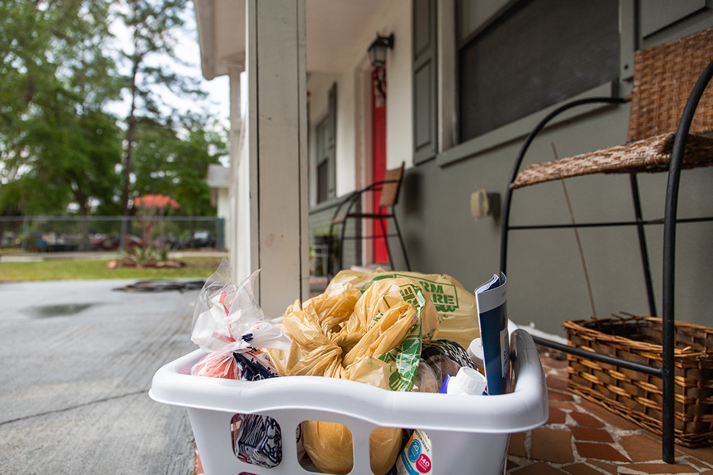
Visual Story Telling Examples

Slide 19
Take Macro Photographs
Use Macro mode for very small subjects or those that you want to get up close to a given detail.
Macro mode on most dedicated cameras is often indicated by a
universal flower icon on the mode dial.
For some interchangeable lens cameras there are
lenses that are just for macro subjects.
On phones, move your camera as close to the
subject as possible where it will still focus on the
subject and take a photo.

Slide 20
Macro Examples

Slide 21
Thank You!
Photo department email – photo@ifas.ufl.edu
Tyler Jones – tylerljones@ufl.edu, (352) 294-3764
Cristina Carrizosa – ccarrizosa@ufl.edu, (954) 850-0917
More IFAS Communications training can be found at: https://branding.ifas.ufl.edu/training/
LinkedIn Learning is also free to UF Personnel and features numerous in-depth tutorials on an assortment of image manipulation software

