Slide 1



UF/IFAS
Social Media Best Practices
Facebook: @UFIFASNews
Twitter: @UF_IFAS
Instagram: @UFIFAS_Solutions
YouTube: @IFASVideo

Slide 2

UF/IFAS Social Media

Slide 3

Resources for Social Media and beyond
Branding.ifas.ufl.edu - https://branding.ifas.ufl.edu/
Social Media resource page
https://ics.ifas.ufl.edu/our-services/social-media/
This Week In UF/IFAS Communications
(weekly e-mail sent to IFAS-Announce)
Regular orientation for new hires and communicators
Bootcamps
Virtual trainings - https://branding.ifas.ufl.edu/training/

Slide 4


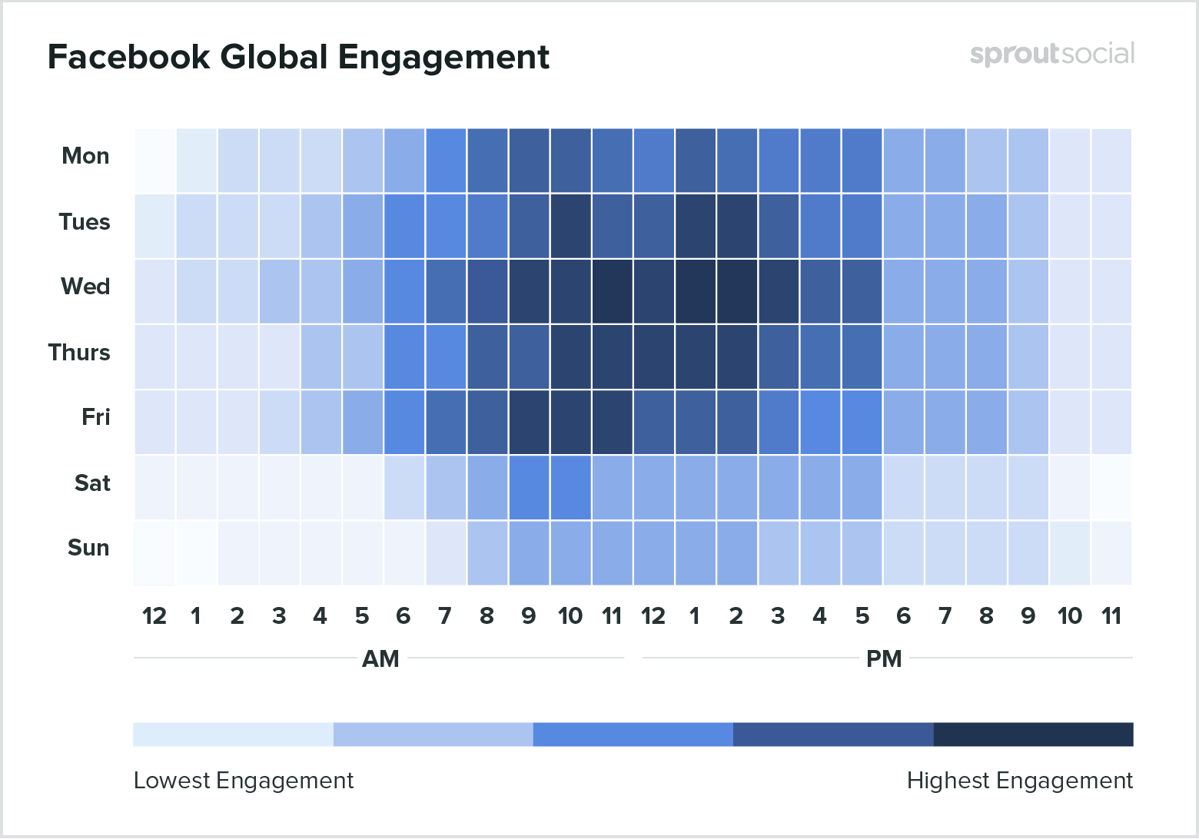

UF/IFAS Social Media
Q: How often should I post?
A: DAILY! (even more is encouraged!)
Q: When should I post?
Q: Length of posts in 2020?
Twitter: 71-100 characters
Facebook: 40-50 characters
Instagram: 125 characters
LinkedIn: 140 characters
YouTube:
Title: 70 characters
Description 5,000 characters
For more on when to post visit link, look for “maintaining a social media account” https://ics.ifas.ufl.edu/our-services/social-media/

Slide 5
A social media page is like a puppy
Feed it content daily
Train your audience
Monitor nothing bad happened
How many puppies do you want?

Slide 6
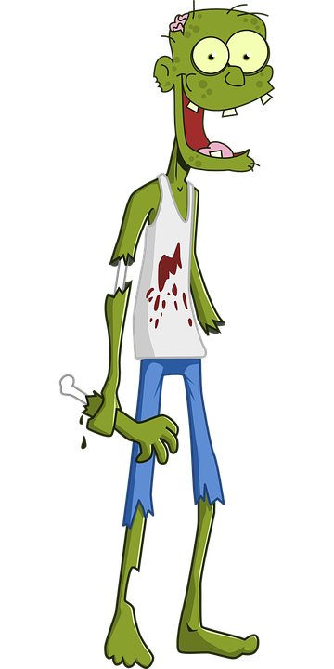


Beware of Zombie accounts!

Slide 7
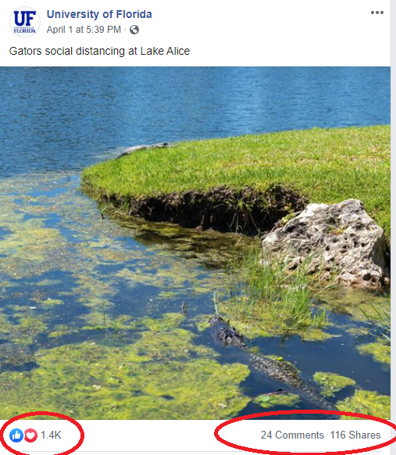
What to post?
Post content that is relevant, engaging and true to the UF/IFAS brand. Got an action item? Make it clear.
Content relevant to Florida
Fun Facts
Content that offers insight
Audience participation (questions)
Don’t be afraid to repost! (UF/IFAS accounts are the best choice)
Make sure all content includes a photo
Social Media Image Sizing Guide
Branding.IFAS.UFL.EDU – infographics

Slide 8

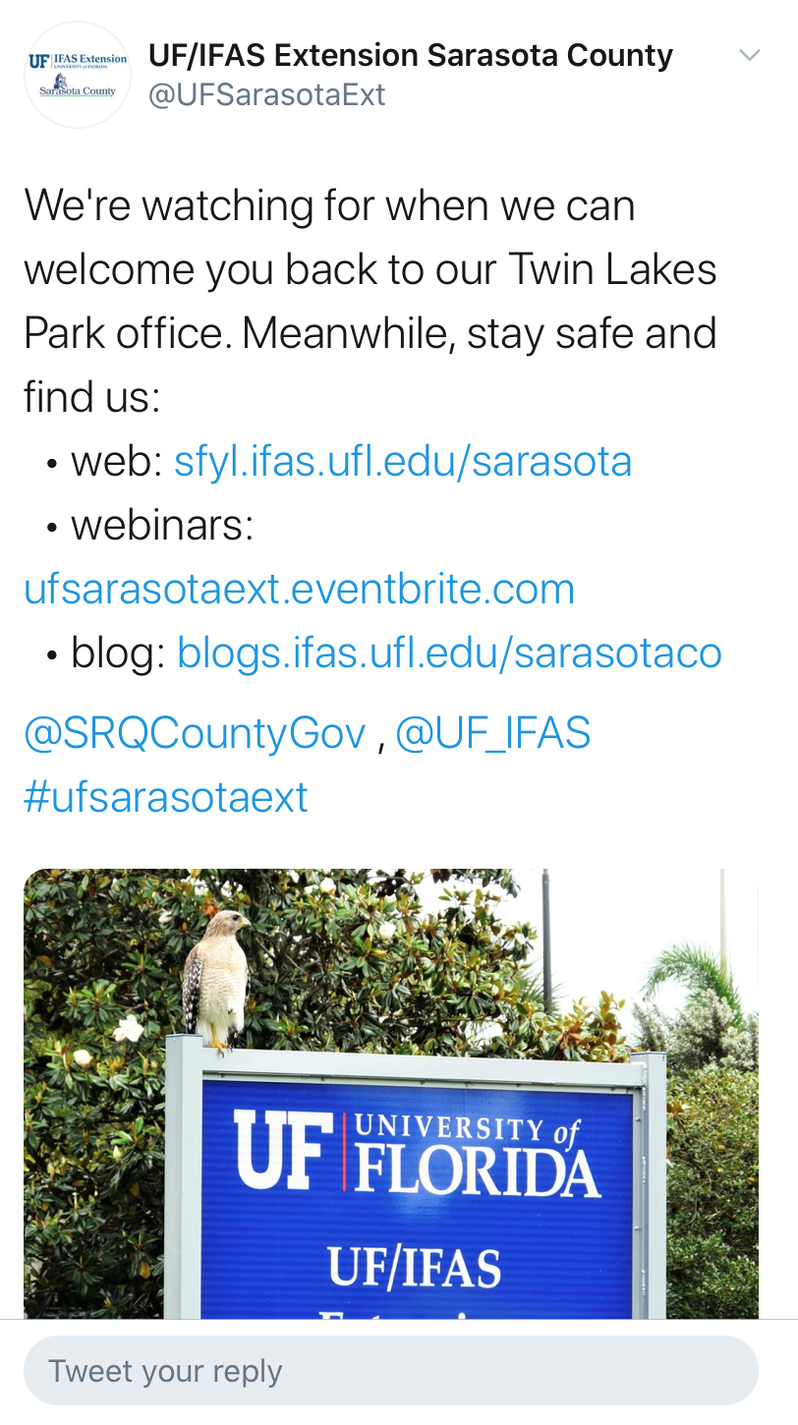
How can I contribute to the digital conversation that’s happening right now?

Slide 9
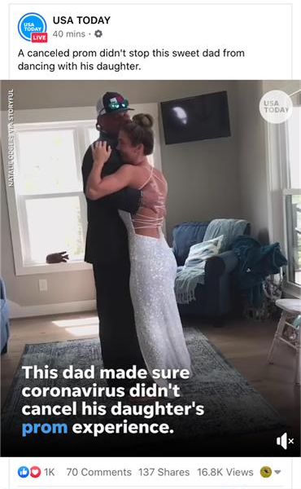
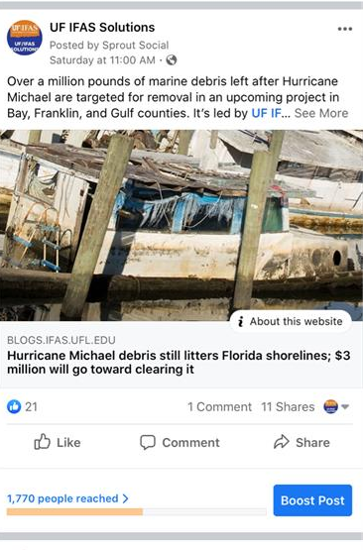
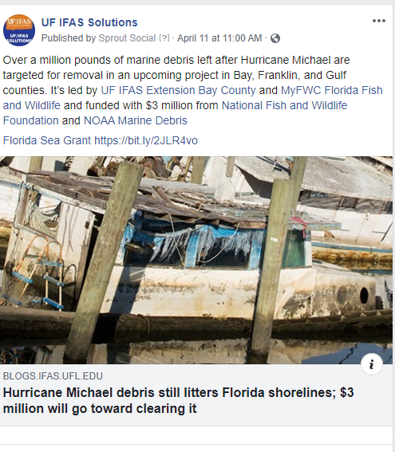
Screenshots taken from Facebook mobile app
Desktop view

Slide 10
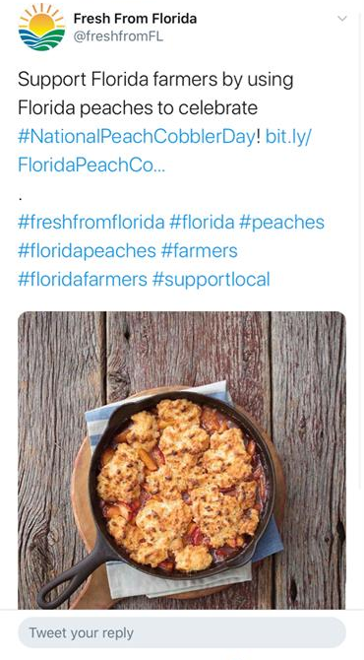
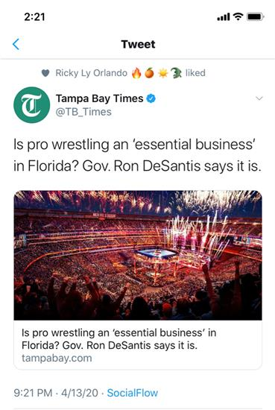
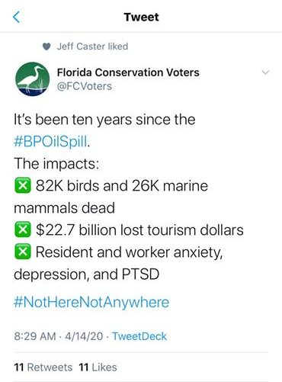
Screenshots taken from Twitter mobile app

Slide 11

#Hashtags
Pillars
#IFASResearch
#IFASExtension
#UFCALS
#UFIFAS
Faculty and Staff recognition
#TeamIFAS
#IFASAtWork
Topic Specific
#UFBugs
#IFASWater
#UFWildlife
#NIFAImpacts
#FLSeaGrant
#4HGrown
#InspireKidsToDo
#AllinforCitrus
#IFASCitrus
#IFASWater
What’s trending today?
What’s trending?
Hashtags are great to use on Twitter and Instagram, not so much on Facebook.
Deeper dive: https://tinyurl.com/ybmo9y5l
Hashtags for every day of the week: https://tinyurl.com/y8l7mncw

Slide 12

Remember to Engage!
Like posts from other UF/IFAS accounts
Is the post relevant to your audience? Share it!
Did someone ask a question in the comments section? Go ahead and give them some resources
Have you looked at your direct messages lately?
Keep track of notifications!
Facebook: Notifications>Activity>Mentions
Twitter:
Check notifications and messages
Instagram:
Paper airplane indicates a message

Slide 13

UF/IFAS Social Media Registration
NEW Social Media Resource page!
https://ics.ifas.ufl.edu/our-services/social-media/
  How to create a page
  What to call it
  How to follow us – free content for you to repost daily!
  Trainings
  Analytics
  Account maintenance advice
On Facebook remember to create a page, not a profile or group

Slide 14
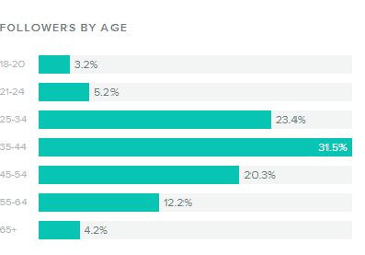
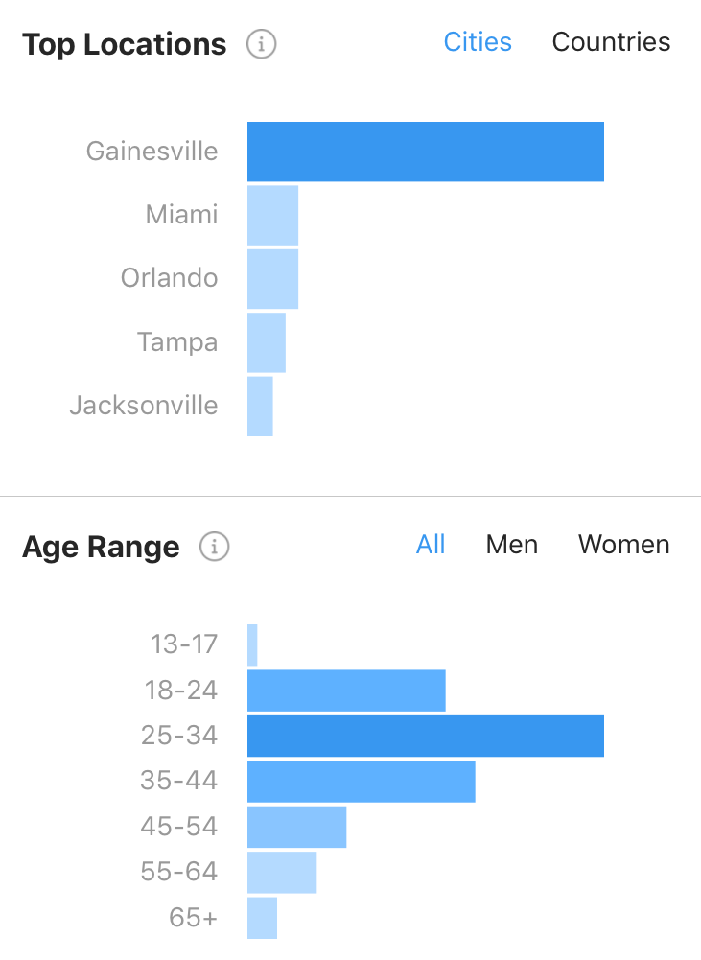
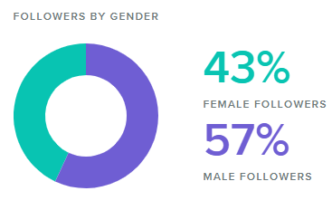
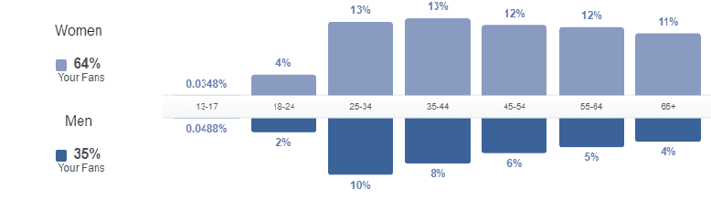
Know Your Audience
Instagram Audience Demographics
Twitter Audience Demographics
Which of your accounts has the most followers?
What’s your audience breakdown by age? Gender?
Don’t post the same thing on every channel.
How do I find key insights for free?
Facebook > Insights > People
Twitter > Click profile photo in top right > Analytics > Audiences in top navigation
Instagram > From profile click three lines on top right > Insights > Audience
Also use analytics to find out what posts do well
Facebook Audience Demographics

Slide 15
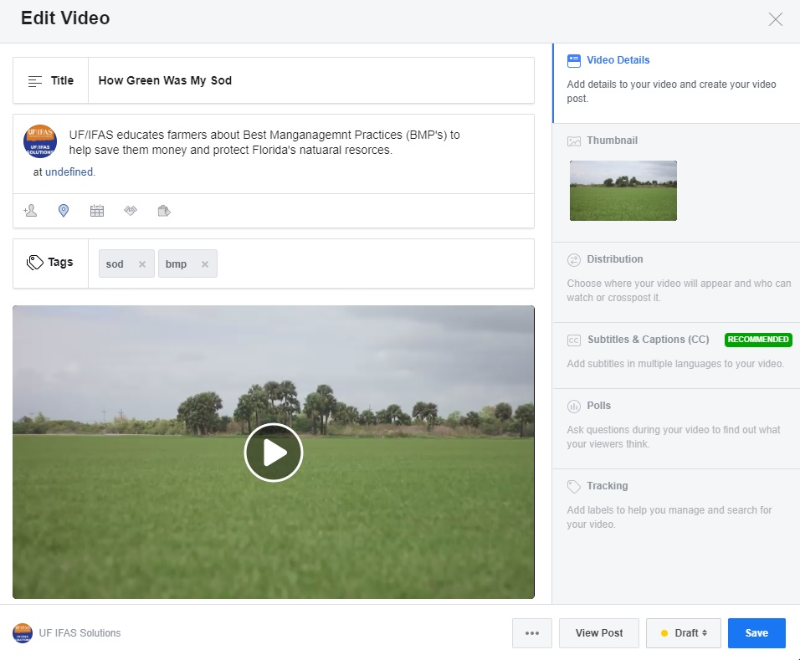
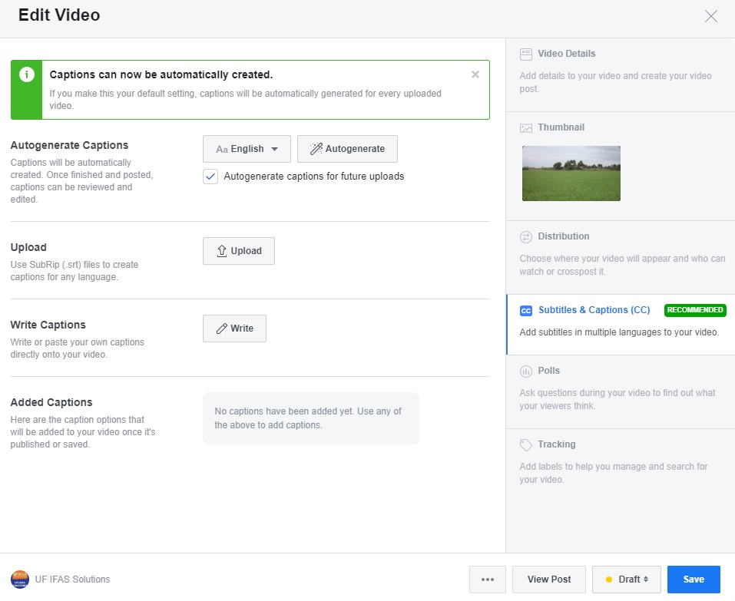
Facebook Captions
85% of social media viewers watch videos with the sound off!
After captions auto-generate hit “edit and review”

Slide 16
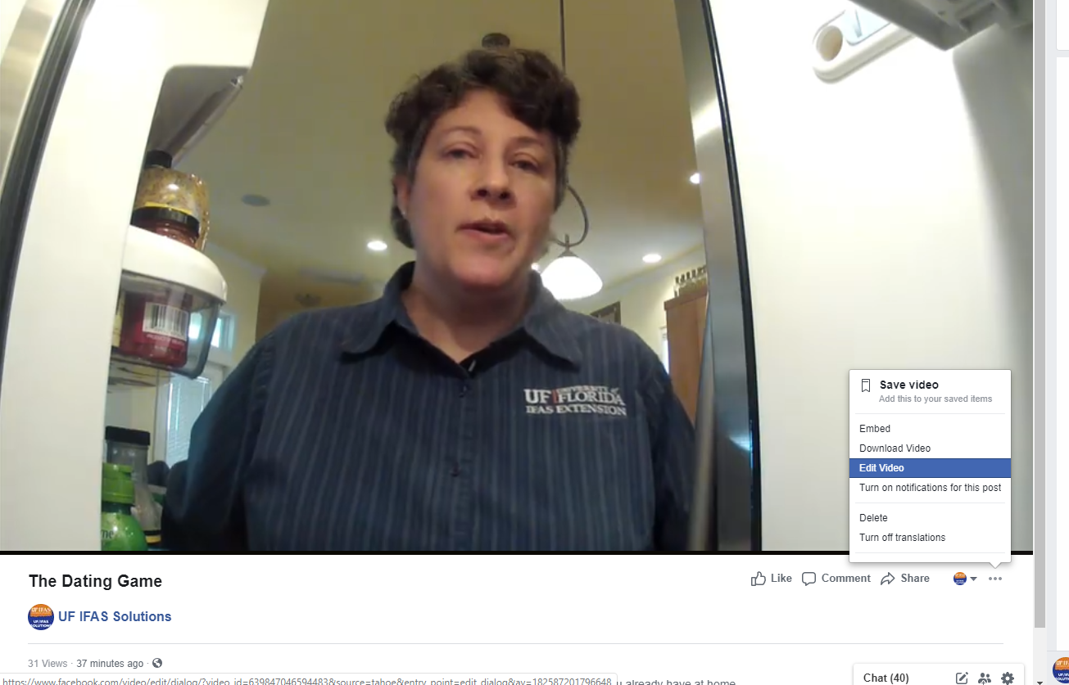
Turn on Facebook captions for published videos
*Make video full screen to see “…”*

Slide 17


Twitter Instagram
Link you YouTube video that includes captions.
Upload the video without captions and link to the YouTube video that does have captions.
Use headliner or another captioning service.
Upload the video without captions. In the chatter below the video, include a link to the YouTube video for closed captions. Note: not a best practice
Use headliner or another service to burn in the captions and then upload the file.

Slide 18

Additional Resources
http://branding.ifas.ufl.edu/social-media-and-blogs/
Don’t suffer in silence, give us a call!
April Martin
UF/IFAS Communications
352-294-3302
April.martin@ufl.edu

Slide 19

Questions?
April Martin – UF/IFAS Digital Content Manager
April.Martin@ufl.edu
Socialmedia@ifas.ufl.edu
352-294-3302
Facebook: @UFIFASNews
Twitter: @UF_IFAS
Instagram: @UFIFAS_Solutions
*Don’t forget to register your accounts with UF/IFAS!

